Slide 1

FALL 2023
MIS 381N
Information management
Lecture 8
Sept 18th 2023
Prashant D. Joshi
UT McCombs School of Business (MSBA), The University of Texas at Austin

Slide 2

Objectives
Data Manipulation Language, cntd
DML
In-class practice
Questions and discussion

Slide 3
What questions may I answer before we begin …
All questions are good questions

Slide 4
Housekeeping

Slide 5
Data Manipulation Language

Slide 6
SQL Overview

Slide 7
SQL Overview - DML

Slide 8
SQL Overview - DML

Slide 9
SQL Select Learning Journey
Basic Syntax
Column Functions
Where clauses
Sorting
Joining tables
Summarizing data
Subqueries
PL/SQL

Slide 10
Select Using Joins

Slide 11
Sometimes the data we need is in multiple tables
Student
CompletedRegistration
Course
StudentId(PK)
StudentFullName
StudentAddress
StudentDoB
1
CompRegistrationId(PK)
StudentId(FK)
CourseId(FK)
Grade (A, B, C, D, F)
N
CourseId(PK)
CourseName
CourseMandatory? (Y, N)
N
1
Has
IsGradedFor
How can we retrieve StudentFullName, CourseName and Grade?

Slide 12
Sometimes the data we need is in multiple tables
Student
CompletedRegistration
Course
StudentId(PK)
StudentFullName
StudentAddress
StudentDoB
1
CompRegistrationId(PK)
StudentId(FK)
CourseId(FK)
Grade (A, B, C, D, F)
N
CourseId(PK)
CourseName
CourseMandatory? (Y, N)
N
1
Has
IsGradedFor
How can we retrieve StudentFullName, CourseName and Grade?
How can we retrieve data correctly from the Student, Course and CompletedRegistration tables?

Slide 13
Sometimes the data we need is in multiple tables
Student
CompletedRegistration
Course
StudentId(PK)
StudentFullName
StudentAddress
StudentDoB
1
CompRegistrationId(PK)
StudentId(FK)
CourseId(FK)
Grade (A, B, C, D, F)
N
CourseId(PK)
CourseName
CourseMandatory? (Y, N)
N
1
Has
IsGradedFor
How can we retrieve StudentFullName, CourseName and Grade?
How can we retrieve data correctly from the Student, Course and CompletedRegistration tables?
We need to look for columns that are the same in multiple tables – the primary and foreign keys?

Slide 14
Join Syntax FROM clause
SELECT column_list
FROM table_1 INNER JOIN table_2 ON join_condition_1
SELECT StudentFullName, CourseId, Grade
FROM CompletedRegistration INNER JOIN Student
ON CompletedRegistration.StudentId = Student.StudentId
SELECT StudentFullName, CourseName, Grade
FROM CompletedRegistration INNER JOIN Student
ON CompletedRegistration.StudentId = Student.StudentId
INNER JOIN Course
ON CompletedRegistration.CourseId = Course.CourseID

Slide 15
Join Syntax table aliases
SELECT column_list
FROM table_1 INNER JOIN table_2 ON join_condition_1
SELECT StudentFullName, CourseId, Grade
FROM CompletedRegistration CR INNER JOIN Student S
ON CR.StudentId = S.StudentId
SELECT StudentFullName, CourseName, Grade
FROM CompletedRegistration CR INNER JOIN Student S
ON CR.StudentId = S.StudentId
INNER JOIN Course C
ON CR.CourseId = C.CourseID

Slide 16
Join Syntax – precisely defining columns
SELECT StudentId, StudentFullName, CourseName, Grade
FROM CompletedRegistration CR INNER JOIN Student S
ON CR.StudentId = S.StudentId
INNER JOIN Course C
ON CR.CourseId = C.CourseID
Student
CompletedRegistration
Course
StudentId(PK)
StudentFullName
StudentAddress
StudentDoB
CompRegistrationId(PK)
StudentId(FK)
CourseId(FK)
Grade (A, B, C, D, F)
CourseId(PK)
CourseName
CourseMandatory? (Y, N)
What should we get as the result?
ORA-00918: column ambiguously defined
00918. 00000 – “column ambiguously defined”

Slide 17
Join Syntax – precisely defining columns
SELECT CR.StudentId, S.StudentFullName, C.CourseName, CR.Grade
FROM CompletedRegistration CR INNER JOIN Student S
ON CR.StudentId = S.StudentId
INNER JOIN Course C
ON CR.CourseId = C.CourseID

Slide 18
Join Syntax where clause
SELECT S.StudentFullName, C.CourseName, CR.Grade
FROM CompletedRegistration CR, Student S, Course C
WHERE CR.StudentId = S.StudentId
CR.CourseId = C.CourseID
NOT RECOMMENDED
Correct syntax but not best practice

Slide 19

Different type of Joins

Slide 20
Select (Multiple Table) Practice

Slide 21
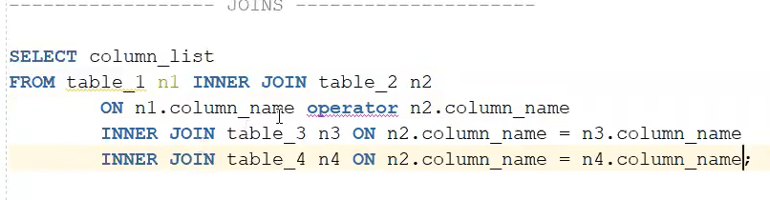
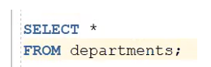
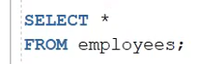
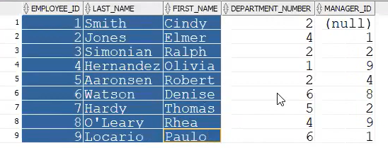
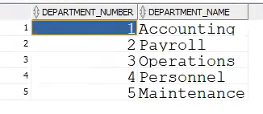
Sometimes the data we need is in multiple tables
Question: Which employees are in which departments?

Slide 22
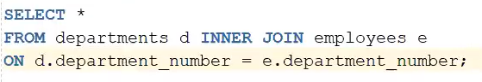
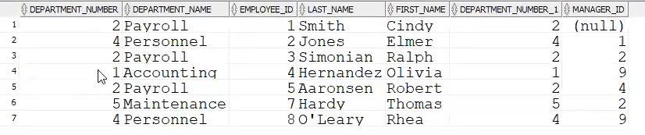
Sometimes the data we need is in multiple tables
Question: Which employees are in which departments?

Slide 23
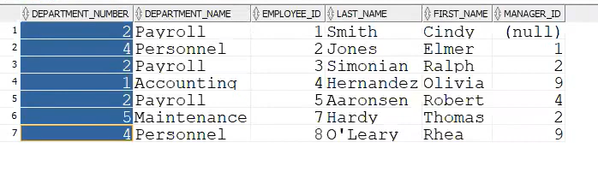
Sometimes the data we need is in multiple tables
Where is Department #3?
Previous query: Note Dept number comes only once in the new and twice in the old, as expected.

Slide 24
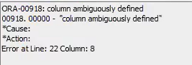
Sometimes the data we need is in multiple tables
Do we need to specify the table alias? Since both are identical, why not avoid giving that info and let SQL take which ever one it likes….
This implies there is ambiguity somewhere in the command…

Slide 25
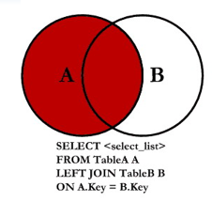
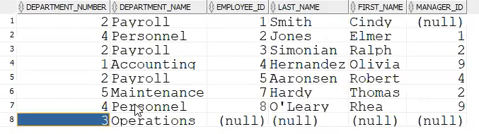
Sometimes the data we need is in multiple tables
Now our Department #3 ‘Operations’ starts to show up!
This is because we are forcing everything in the left to show up, which is the departments table.
BUT
Employee #6 and Employee #9 are still absent
Is this correct? (yes)

Slide 26
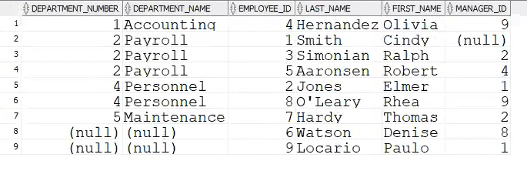
Sometimes the data we need is in multiple tables
Now find all employees and departments
Write this as a RIGHT JOIN
Do this as a RIGHT JOIN, but at times some people find it easier to do think from left to right…
If so, you can convert it into a LEFT JOIN, and the result will be the same as the RIGHT JOIN with the correct table names
Write this as a RIGHT JOIN

Slide 27
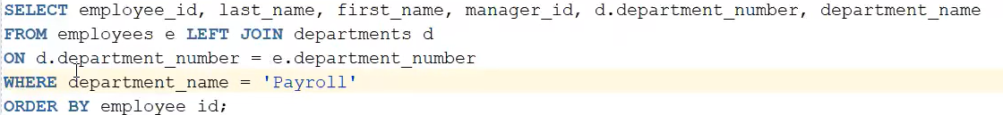
Sometimes the data we need is in multiple tables
What will this do?

Slide 28
UNION, MINUS, INTERSECTION

Slide 29
What if the two tables have no columns in common?
What if we have two tables with data that we want merged, but they don’t have a common column!
Example: Customer data from different divisions, but they all have different customers, and the management wants some selected information on all customers!

Slide 30
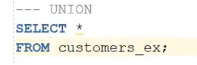
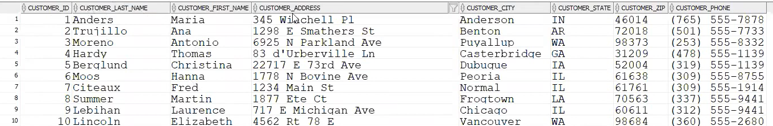
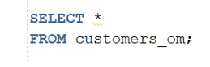
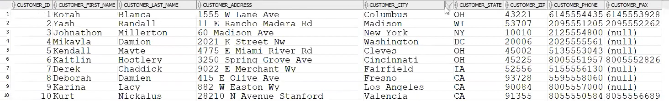
What if the two tables have no columns in common?

Slide 31
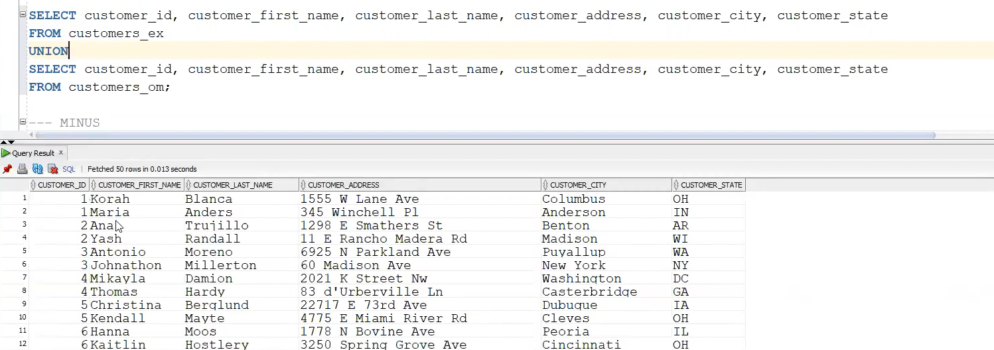
What if the two tables have no columns in common?

Slide 32
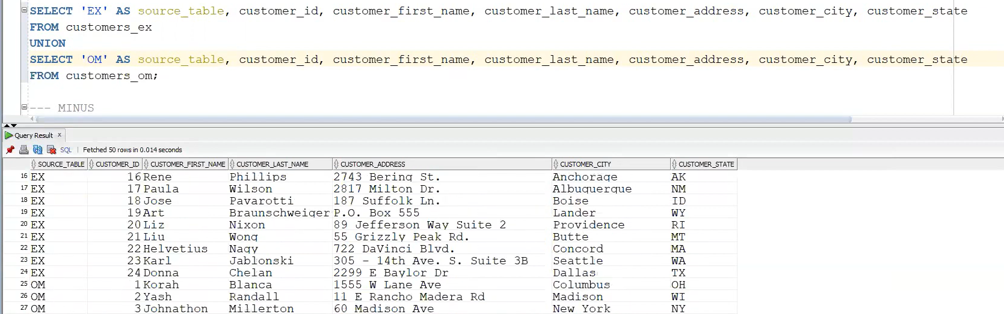
What if the two tables have no columns in common?
For better clarity, use the nifty way of naming the sources

Slide 33
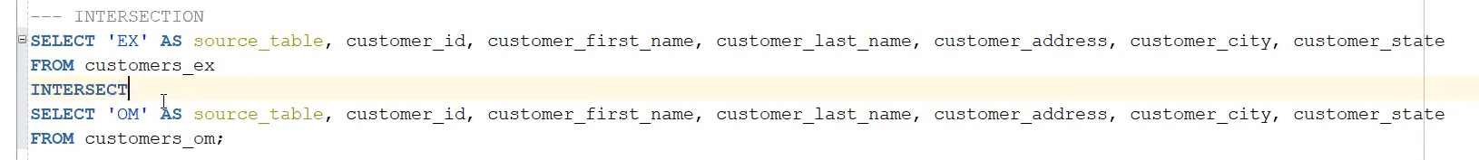
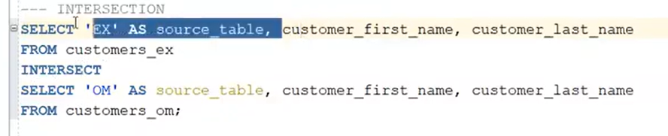
What if the two tables have no columns in common?
INTERSECTION
This results in an empty table, because all the customers are different! But we have customers with the same first and last names in the two tables…..
This ALSO results in an empty table!
The reason is the ‘EX’ and ‘OM’ results in different sources are different

Slide 34
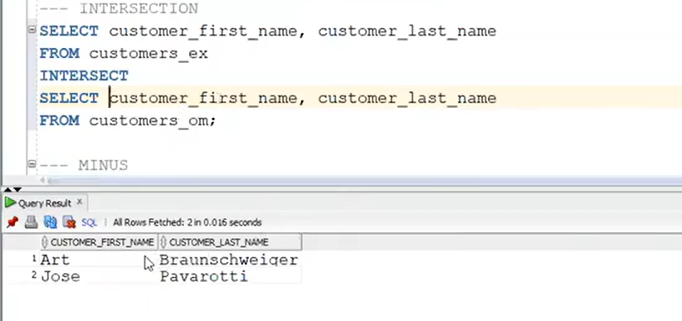
What if the two tables have no columns in common?
INTERSECTION
Keep in mind, these customers might not be the same! This is only because we extracted some info out of the first table and the second table and are doing an ‘INTERSECT’ on the two results, NOT on the original Tables!

Slide 35
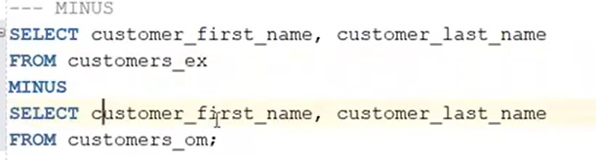
What if the two tables have no columns in common?
MINUS
What do you think this will do?

Slide 36

Next class
Topic Focus: Physical design and DDL
Read articles and review videos posted on Canvas
Come prepared to discuss and work in teams

Slide 37
What questions may I answer before we conclude …
All questions are good questions

Slide 38
Appendix
Summarization Queries

Slide 39
Expanded student entity
Student
What interesting questions might we want to ask?
StudentId(PK)
StudentFirstName
StudentLastName
StudentStreet
StudentCity
StudentState
StudentZip
StudentGender
StudentDoB
Major
Minor
GPA
CreditsCompleted
DateEnrolled

Slide 40
Summarization questions
Student
How many students do we have in a particular major?
Minor?
Gender?
State?
City?
What is the average GPA of students in a particular major?
What are the total and average credits completed by major based on date enrolled?
Does this change by minor?
Gender?
…
StudentId(PK)
StudentFirstName
StudentLastName
StudentStreet
StudentCity
StudentState
StudentZip
StudentGender
StudentDoB
Major
Minor
GPA
CreditsCompleted
DateEnrolled

Slide 41
Select syntax for summary data
SELECT Columns - Column names - Arithmetic expressions - Literals (text or numeric) - Scalar functions - “Aggregate” functions
FROM Table or view names
WHERE. Conditions (qualifies rows)
GROUP BY Creates sub totals
with column functions
ORDER BY Sorts result rows
How many students do we have in a particular major? Select count(studentid), major from student group by major
What is the average GPA of students in a particular major? Select avg(GPA), major from student group by major

Slide 42
Common Oracle column functions
SELECT Columns - Column names - Arithmetic expressions - Literals (text or numeric) - Scalar functions - “Aggregate” functions
FROM Table or view names
WHERE Conditions (qualifies rows)
GROUP BY Creates sub totals
with column functions
ORDER BY Sorts result rows
AVG
COUNT
MAX
MEDIAN
MIN
SUM
Also known as aggregate and analytic functions

Slide 43
Common errors
select count(studentid), major, minor from student
group by major
ORA-00979: not a GROUP BY expression
00979. 00000 - "not a GROUP BY expression"
*Cause:
*Action:
select count(studentid), major, minor from student
group by major, minor

Slide 44
Common errors
select studentid, major from student
group by major
ORA-00979: not a GROUP BY expression
00979. 00000 - "not a GROUP BY expression"
*Cause:
*Action:
select count(studentid), major from student
group by major

Slide 45
Having clause
SELECT Columns - Column names - Arithmetic expressions - Literals (text or numeric) - Scalar functions - “Aggregate” functions
FROM Table or view names
WHERE. Conditions (qualifies rows)
GROUP BY Creates sub totals
with column functions
HAVING Aggregate condition
ORDER BY Sorts result rows
How many majors do we have where the average GPA is less than 3.0? What is the count of student is such majors? Select count(studentid), major from student group by major having (avg(GPA) < 3)
How many students do we have by major with a GPA < 3 select count(studentid), major from student where GPA < 3 group by major

